Slide 1
Cybergirls Girl Scouts LEGO Robotics
Cybergirls
Meeting 5 – Project
August 8, 2017

Slide 2
What are we doing today?
Rockin’ Robots vs Cybergirls
Review your program from last meeting
Talk about the Competition
Talk about Core values
Building a Car

Slide 3
Homework
Write a program that uses a loop with an if statement
>>>myage()
Allie was 0 years ago a long time ago
Allie was 1 years ago a long time ago
Allie was 2 years ago a long time ago
Allie was 3 years ago a long time ago
Allie was 4 years ago a long time ago
Allie was 5 years ago a long time ago
Allie was 6 years ago a long time ago
Allie was 7 years ago a long time ago
Allie was 8 years ago a long time ago
Allie was 9 years ago a long time ago
Allie was 10 years ago a long time ago
Allie is 11 today!

Slide 4

What is this about?
The branch of science concerned with forces acting on or exerted by fluids (especially liquids).

Slide 5
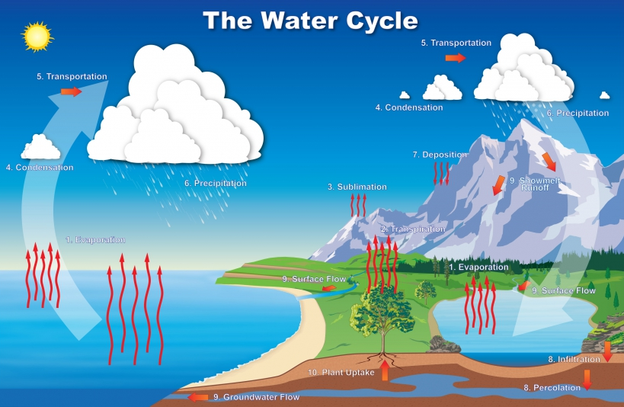
The Water Cycle

Slide 6
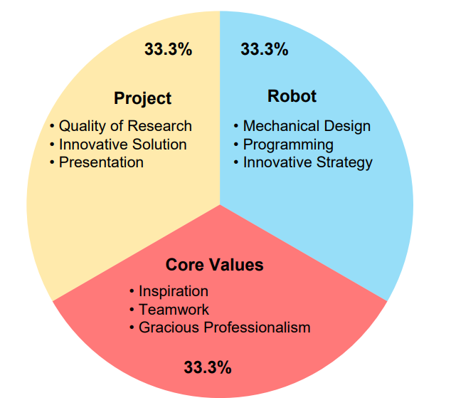
LEGO Competition
Notes:
Bottled water plant

Slide 7
Timeline
Practice Tournaments (late Oct - early Nov)
Qualifying Tournaments (Nov 4 (2, one near LAX), 5, 11, 12, 18, 19, 25)
Championship Tournament

Slide 8
Core Values
We are a team.
We help each other no matter what because we know that if we don’t help each other we will end up with nothing like we will end up without an answer.
We know we will not always get the answers so we try our best on anything.
As a team we always learn, work, and have fun with each other.
We do the work to find solutions with guidance from our Coaches and Mentors.
We know our Coaches and Mentors don’t have all the answers; we learn together.
We start off with no answers and we learn together
We can find the correct answers if we work together
We can help our coaches and mentors find the answers
We honor the spirit of friendly competition.
What we discover is more important than what we win.
It doesn’t matter what we win, it is about the journey we went through to make it happen.
It doesn’t matter what we win, it matters that we did it together.
The knowledge we gain from this experience will always be better than the win.
We share our experiences with others.
Sharing what we learn with others teams at competitions if they need help
By not hiding our ideas and letting other people know what we think
And show coorperation with a little competition
We display Gracious Professionalism® and Coopertition® in everything we do.
We use positive words when we are with our team
Treat your team well by listenining to others
Give good advice and stay focused
We have FUN!
Make competitions to make our robots better
Create more programs to make the robot do challenges
It was fun to put legos together
It does not matter if we win or not. It matters that we have fun together.
We are in this together to have a great time and learn
Having fun learning helps us gain more knowledge. We make learning fun.

Slide 9
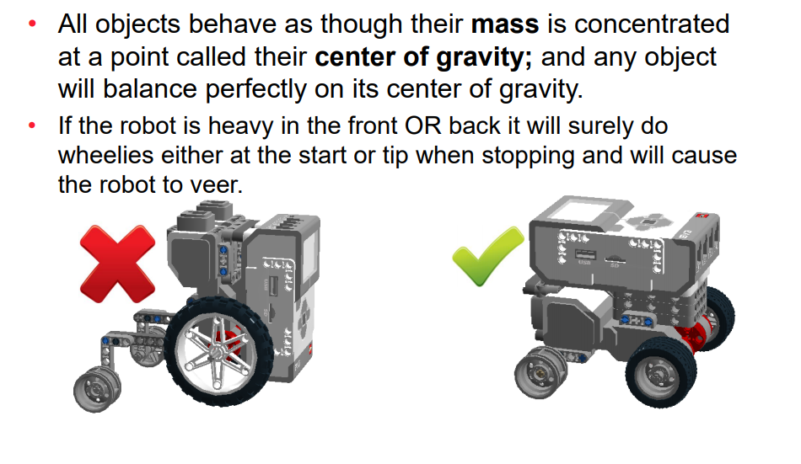
Concept of the Day: Center of Gravity

Slide 10
Build a Car
Look at the parts we’ll use

Slide 11

Next Meeting
Circles and Wheels
Who knows what PI is?
Using a text editor

